Slide 1
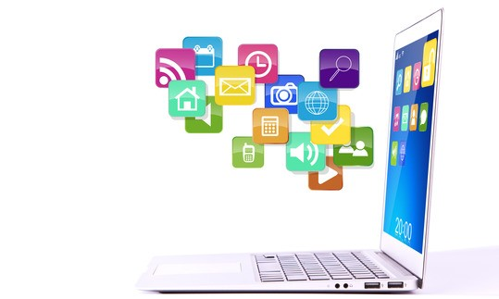
Application of computers

Slide 2
Introduction
Computers have grow rapidly into various areas of our lives.
For a user, computer is a tool that provides the desired information, whenever needed.
You may use computer to get information about the reservation of tickets (railways, airplanes ), books in a library, medical history of a person, a place in a map, or the dictionary meaning of a word.
The information may be presented to you in the form of text, images, video clips, etc.

Slide 3
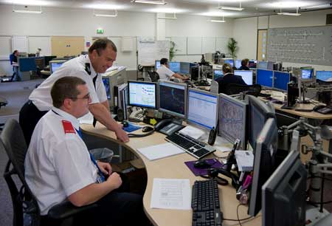
Government Applications
Computers play an important role in government applications. Some major fields in this category are:
Computerization of Driving Licensing system
Computerization of voters lists
Computerization of NIC card and passport.
Budgets
Sales tax department
Income tax department
Population department.

Slide 4
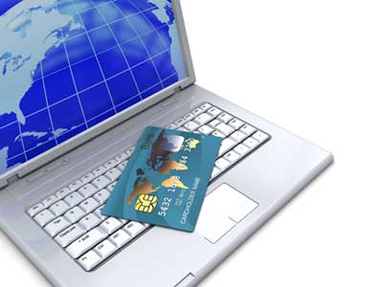
Banking
Today Banking is almost totally dependent on computer.
Banks provide following facilities:
Banks on-line accounting facility, which includes current balances, deposits, overdrafts, interest charges, shares and records.
ATM machines are making it even easier
for customers to deal with banks.

Slide 5
Engineering Design
Computers are widely used in Engineering purposes.
One of major areas is CAD (Computer aided design).
CAD provides creation, edition, and modification of image. Some fields are:
Structural Engineering: It deals with design of Ships, Buildings, Bridges, Airplanes, etc.
Industrial Engineering: Computers deal with design, implementation and improvement of Integrated systems of people, materials and equipments.

Slide 6

Continue……………………
Architectural Engineering: Computers help in planning towns, designing buildings, determining a range of buildings on a site using both 2D and 3D drawings.

Slide 7
Education
The computer has provided a lot of facilities in the Education System.
The uses of computer provide a tool in the Education system known as CBE (Computer Based Education).
Educators use computers to prepare notes and presentations of their lectures.
Computers are used to develop computer-based training packages, to provide distance education using the e-learning software, and to conduct online examinations.
Researchers use computers to get easy access to conference and journal details and to get global access to the research material.
There are number of methods in which educational institutions can use computer to educate the students.

Slide 8
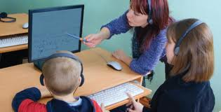
Continue………….
The computer education is very familiar and
rapidly increasing the graph of computer students.

Slide 9
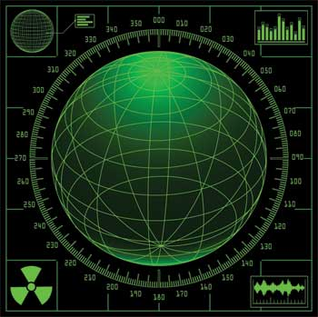
Military
Computers are largely used in defence.
Modern tanks, missiles, weapons, etc., employ computerized control systems.
Some military areas where a computer has been used are:
Missile Control
Military Communication
Military operation and planning
Smart Weapons

Slide 10
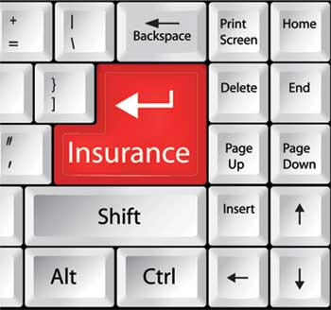
Insurance
Insurance companies are keeping all records up-to-date with the help of computers.
The Insurance Companies, Finance houses and Stock broking firms are widely using computers for their concerns.
Insurance Companies are maintaining a database of all clients with information showing:
how to continue with policies
starting date of the policies
next due installment of a policy
maturity date
interests due
survival benefits
bonus

Slide 11
Health Care
Computers have become important part in all Medical Systems.
The computers are being used in hospitals to keep the record of patients and medicines.
It is also used in scanning and diagnosing different diseases.
ECG, EEG, Ultrasounds and CT Scans, etc., are also done by
computerized machines.
Some of major fields of health care in which computers are used:
Diagnostic System: Computers are used to collect data and identify cause of illness.
Lab-diagnostic System: All tests can be done and reports are prepared by computer.
Patient Monitoring System: These are used to check patient's signs for abnormality such as in ECG, etc.

Slide 12

Continue………….
Pharma Information System: Computer checks Drug-Labels, Expiry dates, harmful drug side effects, etc.
Nowadays, computers are also used in performing surgery.

Slide 13

Business
Computer is used in business organization for:
Financial forecasting
Managing employees database
Maintenance of stocks, etc.
Payroll Calculations
Budgeting
Sales Analysis

Slide 14
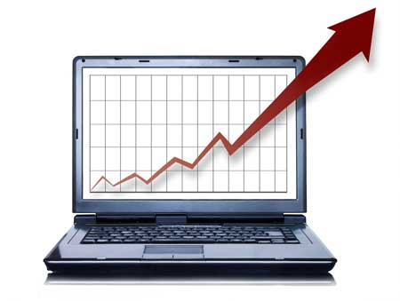
Marketing
In Marketing uses of computer are following:
Advertising: With computers, advertising professionals create art and graphics, write and revise copy, and print and publish ads with the goal of selling more products.
At Home Shopping: Home shopping has been made possible through use of computerized catalogues that provide access to product information and permit direct entry of orders to be filled by the customers.

Slide 15

Entertainment
Computers have had a major impact on the entertainment industry.
The user can download and watch movies, play games, chat, book .
The users can also listen to music, download and share music, create music using computers, etc.

Slide 16
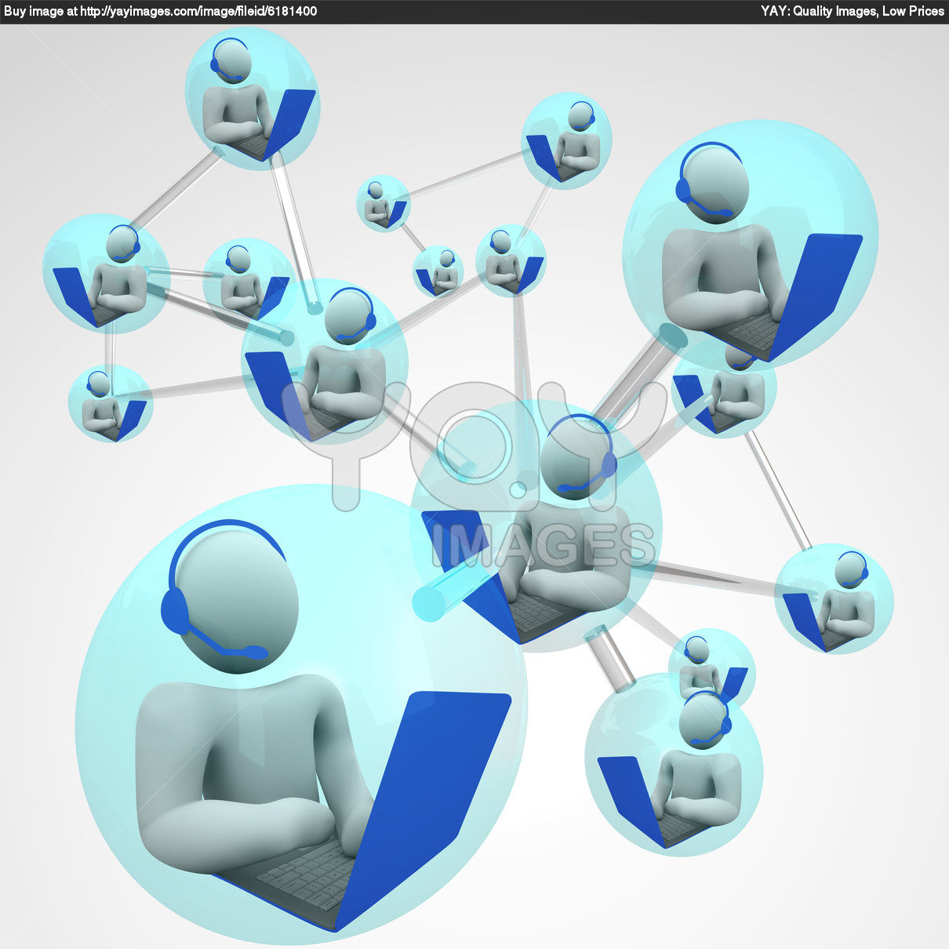
Communication
Communication means to convey a message, an idea, a picture or speech that is received and understood clearly and correctly by the person for whom it is meant.
Some main areas in this category are:
Video-conferencing
E-mail
Chatting

Slide 17
Thank You

